Slide 1


ASEM2M 9502 Information info@ase-corp.com http://m2m.ase-corp.com

Slide 2
BGAN M2M

Slide 3
Broadband Global Area Network
(BGAN)

Slide 4
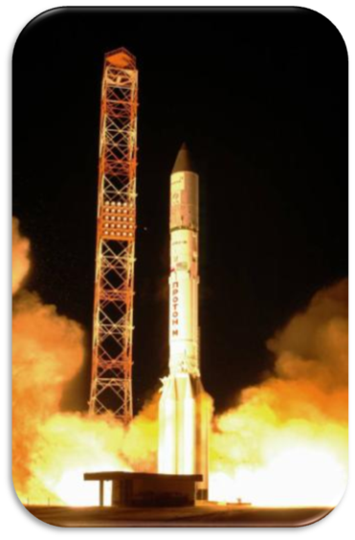
Inmarsat-4 (I-4) Satellites
Part of a total constellation of 11 satellites in geostationary orbit around the equator
The Inmarsat-4 (I-4) network of Satellites is the backbone of BGAN
Most advanced network of commercial communications satellites ever launched
$1.5 billion investment
Support latest generation of mobile broadband services
Commercial life into the 2020’s
Courtesy ILS & Lockheed Martin Corporation
Courtesy: ILS

Slide 5
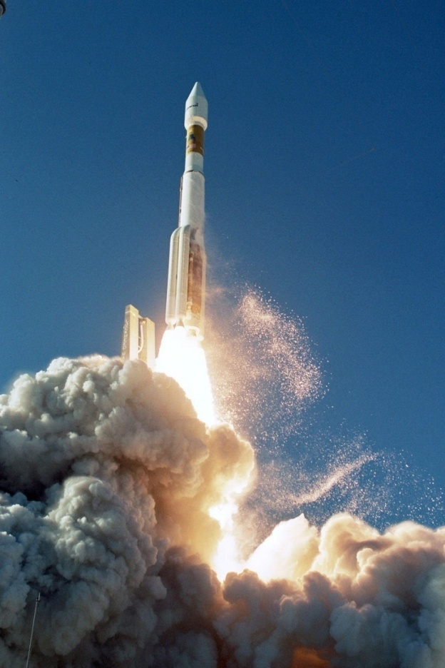
Inmarsat BGAN
Broadband Global Area Network
Broadband data (up to 492 kbit/s)
… plus voice for some terminals
Accessible simultaneously
Global coverage
L-Band (no weather influence)
99.9% availability

Slide 6
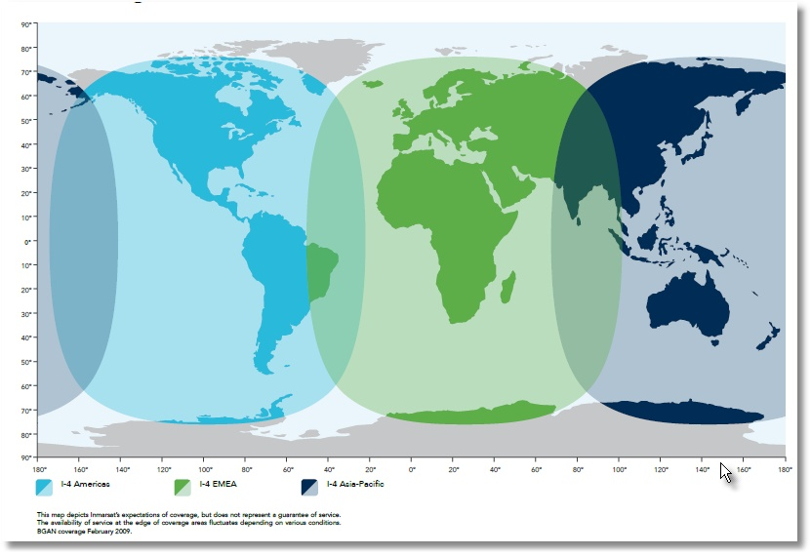
BGAN Global Coverage I4 Satellites

Slide 7
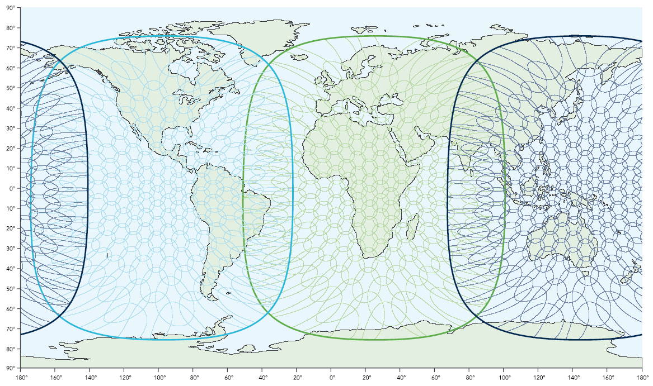

BGAN Coverage Map

Slide 8
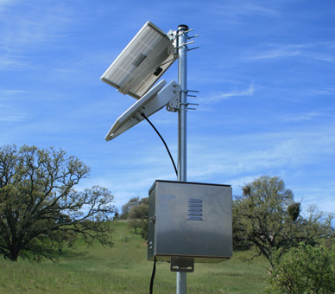
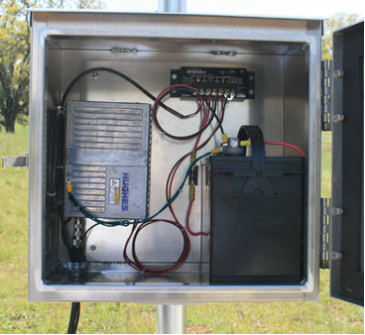
BGAN 9502 Overview
First BGAN terminal made specifically for fixed site, remote SCADA applications
BGAN 9502 comprised of an Indoor Unit (IDU), an external passive antenna (outdoor unit – ODU) and a 10-meter RF cable.
Main Features :
  BGAN Class 2 data service – up to 464kbps.
  IP packet data transfer via the BGAN satellite network
  Remote Web User interface
  AT Command Control
  Remote SMS
  IP Watchdog
  Remote firmware upgrade
  Easy to install!
Mounted with optional
enclosure & solar panel
Mounted with optional
enclosure

Slide 9
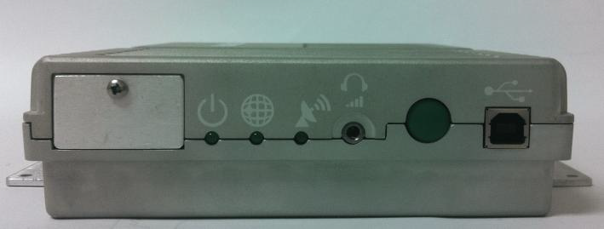
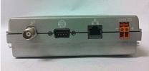
BGAN 9502 Overview
Interfaces :
  Single Ethernet connection (RJ45)
  USB 1.1 connection (USB Type-B) for PC to configuration terminal
  TNC (RF) connector on IDU and N-type connector on external antenna
  Integrated GPS receiver and antenna
  RS232 serial interface (DB9) to external NMEA 0183 based GNSS device (e.g. GLONASS receiver) NOTE – this is not an RS-232 to be used for serial data!
  3 LED status display and a single button control interface
  3.5 mm audio jack for audio tone or voltage level to assist in antenna pointing
  USIM card slot behind SIM door

Slide 10
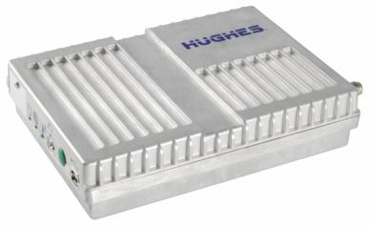
BGAN 9502 Overview
Terminal Certifications
  FCC
  CE
  CSA
  RoHS
  EWRA
Class 1 Division 2 configuration
available, as well

Slide 11
BGAN 9502 Overview
Easily battery/solar powered for remote installs
Power Consumption:
  The Hughes 9502 will consume <1W when in idle mode on the network. Idle mode is defined as having an active PDP context but the UE has already transitioned back to the regional beam due to 90 seconds of data inactivity. In idle mode the UE is still accessible by IP traffic from the network.
  There are two ways to put the UE into an “Off” state for even more power savings:
        The RTU can apply >2.2V @ 1 MΩ to the discrete input Pin#9 on the DB-9 connector to turn the UE Off (Pin#9 is positive and Pin#5 is ground) . When the RTU removes the 2.2V, the UE will start back up.
        Via a local AT command, a remote SMS command or a configurable timeout from inactivity on the LAN connection, you can turn the UE “Off”, but the Ethernet connection will maintain the active pulses and wake up when any LAN packet is sent to the UE.
        The power consumption for either of these two options will be <50mW.

Slide 12
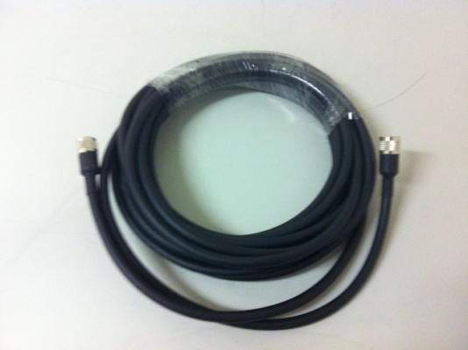
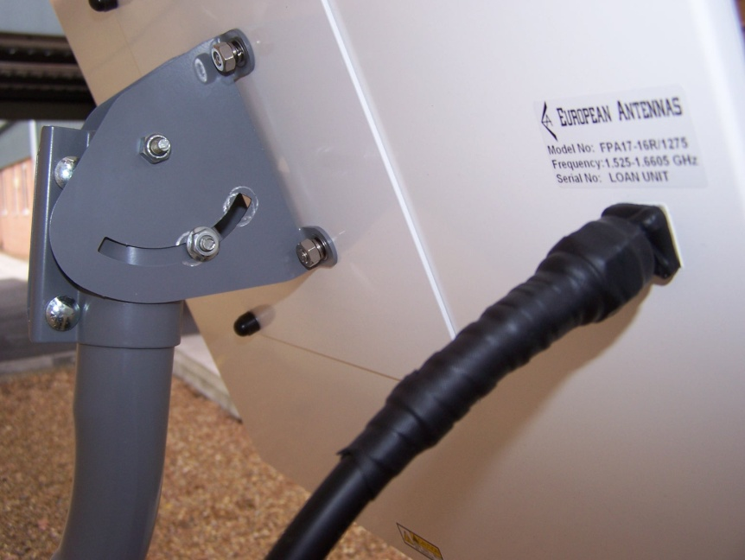
BGAN 9502 Overview
Hughes 9502 Kit contents:
  9502 Indoor Unit (IDU)
  Class 2 antenna – 15” x 15” (ODU)
  10M RF cable with TNC connector for IDU and N-type connector for external antenna

Slide 13
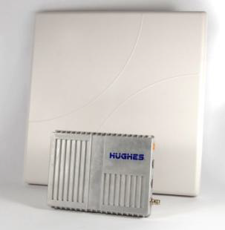
BGAN 9502 Overview
Optional items:
  IDU strap for mounting in enclosures
  Azimuth elevation bracket
  Basic Fix Mount Kit (includes azimuth bracket)
  AC/DC adapter
    Note: Other cable lengths may be used – must be 1.8dB +/- .5dB loss from end to end

Slide 14
Technical Specifications
Technical Specifications
Satellite TX Frequency | @ 1626.5 – 1675MHz
Satellite RX Frequency | @ 1518 – 1559 MHz
GPS Frequency | @ 1574.42 – 1576.42 MHz
9502 Indoor Unit Weight: | < 1.5 Kg
9502 Indoor Unit Dimensions: | 150 mm x 200 mm x 45 mm
9502 External Antenna Weight: | < 1.9 Kg (exclude mount and cable)
9502 External Antenna Dimensions: | 385 mm x 385 mm x 33 mm
Operating Temperature | -40ºC to +75ºC
Storage Temperature | -25ºC to +80ºC
Humidity | 95% RH at +40ºC
9502 External Antenna Wind loading | Survival wind loading (with optional mount) up to 100 mph
9502 Indoor Unit Water and Dust | IP-40 Compliant
9502 External Antenna Water and Dust | IP-65 Compliant
Input Voltage Range | +12VDC to +28VDC
Data Connectivity: | RJ45 connector (Ethernet 10BaseT)
 | USB –Type B connector (USB 1.1 for connection to configuration PV)
Other Features:
 | Single external BGAN Satellite and GPS antenna connection
 | GPS module inside Indoor Unit
 | 3 status LEDs
 | Antenna pointing audio tone and voltage level indicator through audio jack
 | SIM/USIM Slot (behind SIM door)

Slide 15
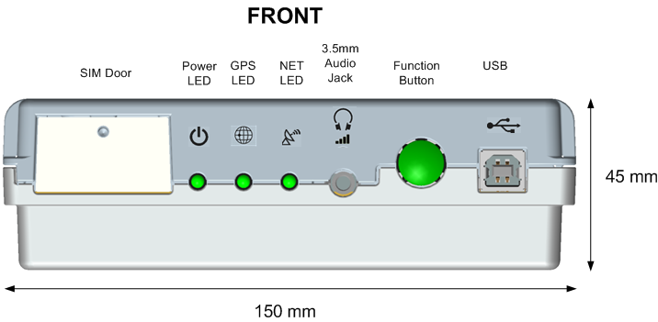
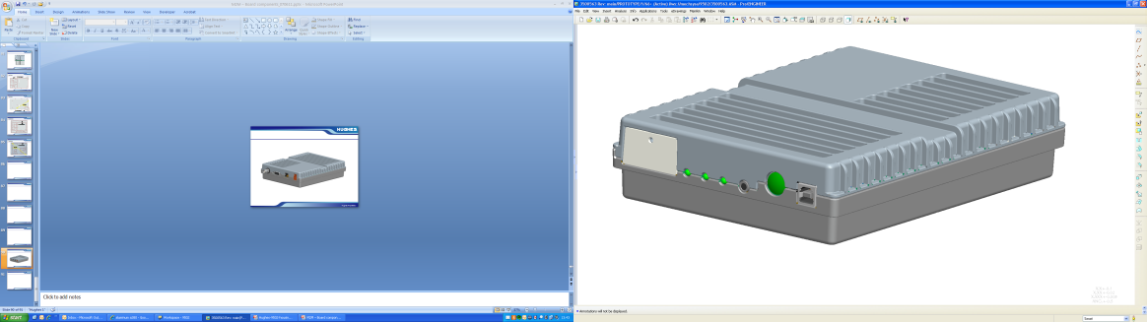
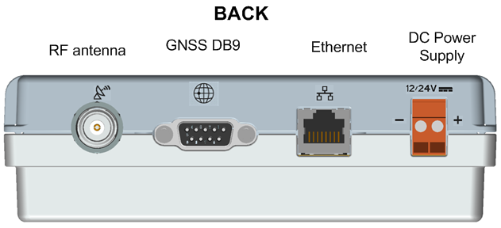
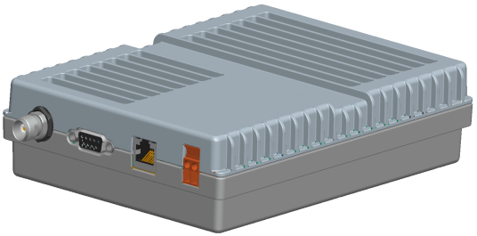
9502 IDU

Slide 16
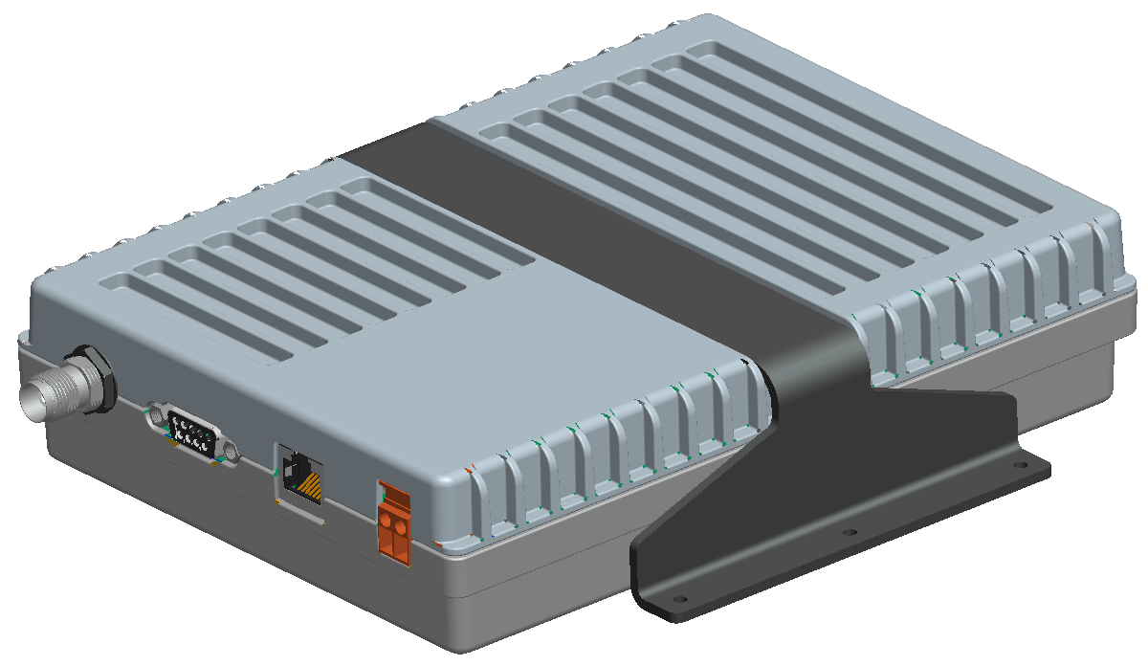
IDU with Optional Mounting Strap
2.5 mm Thick
Aluminum Bracket
3.8 mm deep channel
to hold the bracket

Slide 17
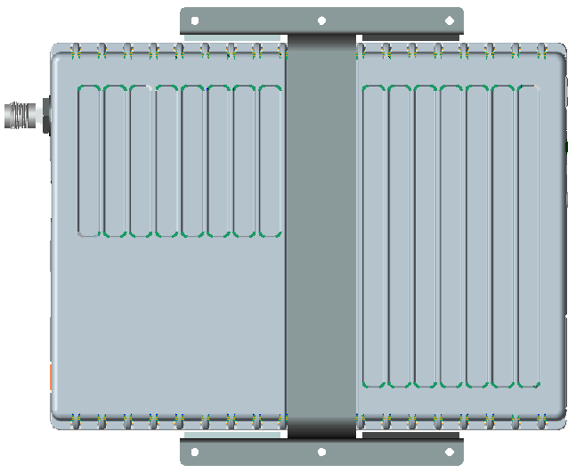
IDU Top View with Optional Strap
7.87 inches
M6 or 6-32 size bolt
5.9 inches

Slide 18
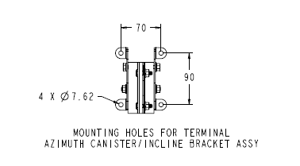
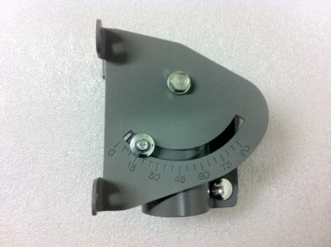
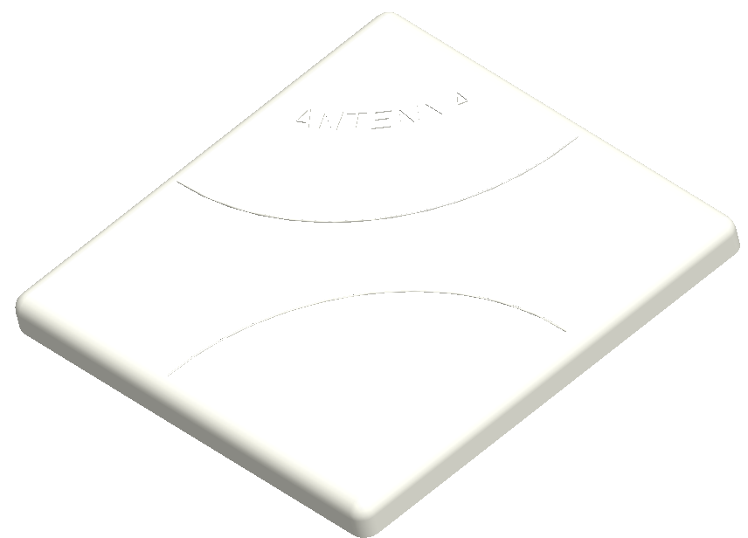
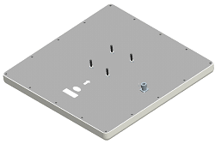
Antenna & Mounting Dimensions
Optional azimuth bracket

Slide 19
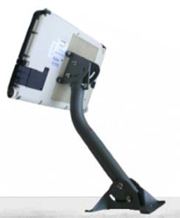
Optional Equipment
  Basic Fix Mount Kit
  Includes Azimuth Canister Bracket
  Used to mount 9502 external antenna
  Fixed mount stand
  Ground cable
  Level
  Installation guide

Slide 20
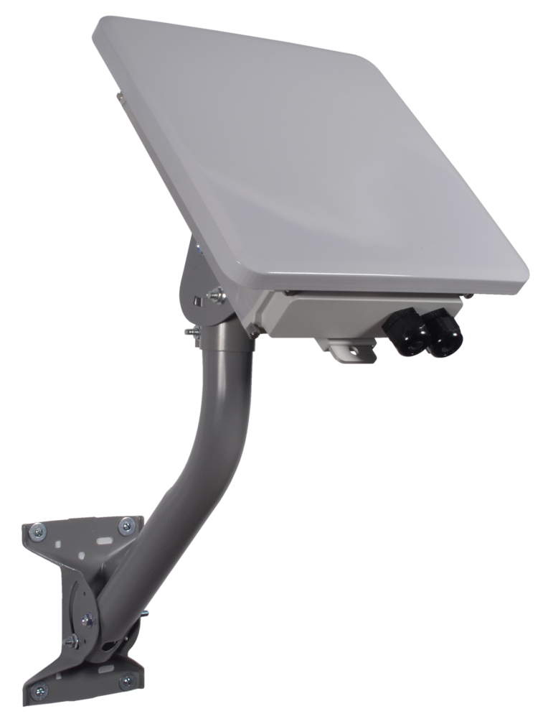
One Piece 9502!
  Same IDU and specs at 9502
  One piece design – no antenna cable or connectors
  No need for enclosure for IDU
  Easier to install
  (mounting bracket optional)

Slide 21
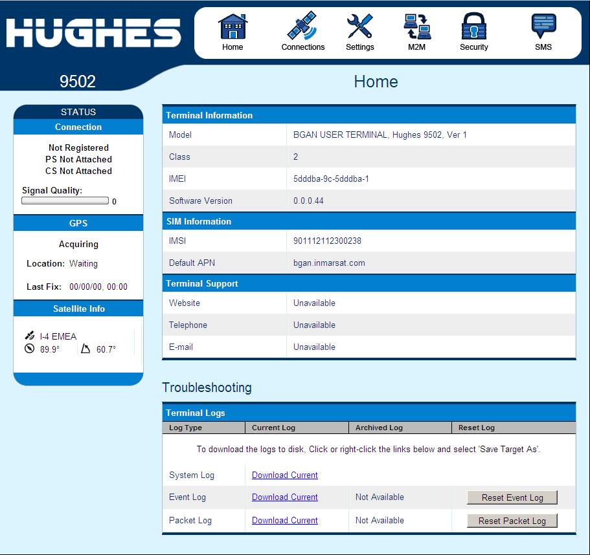
Hughes 9502 WebUI
Browser interface for easy installation/configuration of unit
  New look and feel for the 9502 WebUI
  Gives the installer all the information required for pointing and getting the terminal connected to the network
  Security enhancements lock configuration settings/pages

Slide 22
Hughes 9502 Summary
  Only BGAN unit designed for stand-alone, remote site deployment
  Only BGAN unit to offer SCADA pricing plans and no minimum session charges
  Easy to install
  Very low power
  Global coverage

Slide 23
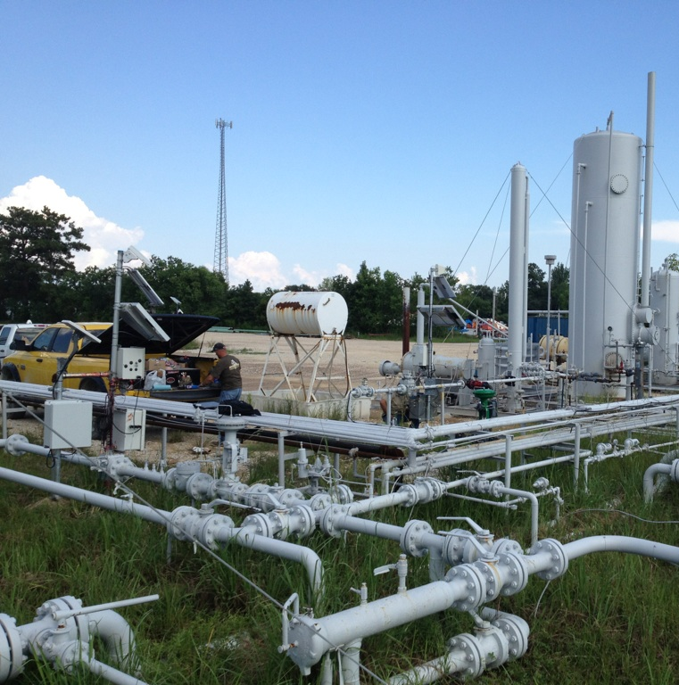
Finally, A Note from an Install Tech
“This is a picture of a 9502 I just installed today. Notice the 9502 in the left side of the picture. This unit is polling 4 TotalFlow RTU’s. Next, notice the Technician sitting…he is trying to get a cellular modem to poll one TotalFlow RTU. Also, notice the cell tower about 400 yards away. I started the installation about 4 hours after the Technician pictured. I am on my way home now and he is still there and his installation is still not working! Score one for Inmarsat!”

